Slide 1
Principal Components Analysis

Slide 2
Steps of PCA:
Standardize the data: If the features are on different scales, we standardize them to have mean 0 and variance 1.
Compute the covariance matrix: This matrix captures the correlations between features.
Compute the eigenvalues and eigenvectors of the covariance matrix: The eigenvectors represent the directions (components) and the eigenvalues represent the magnitude of the variance in those directions.
Sort the eigenvalues and their corresponding eigenvectors: The eigenvector with the highest eigenvalue is the first principal component, the next is the second, and so on.
Project the data onto the new feature space: Multiply the standardized data by the top k eigenvectors (components) to get the new k-dimensional representation.

Slide 3
Covariance
Variance and Covariance are measures of the “spread” of a set of points around their center of mass (mean)
Variance – a measure of the deviation from the mean for points in one dimension e.g., heights
Covariance as a measure of how much each of the dimensions varies from the mean with respect to the others.
Covariance is measured between 2 dimensions to see if there is a relationship between the 2 dimensions, e.g., number of hours studied & marks obtained.
The covariance between one dimension and itself is the variance

Slide 4
Covariance
covariance (X,Y) = Σ
n
(X – X) (Y – Y)
i=1 i i
(n -1)
So, if you had a 3-dimensional data set (x,y,z), then you could measure the covariance between the x and y dimensions, the y and z dimensions, and the x and z dimensions. Measuring the covariance between x and x, or y and y, or z and z would give us the variance of the x, y, and z dimensions, respectively.

Slide 5
Covariance Matrix
Representing Covariance between dimensions as a matrix e.g. for 3 dimensions:
cov(x,x) cov(x,y) cov(x,z)
C = cov(y,x) cov(y,y) cov(y,z)
cov(z,x) cov(z,y) cov(z,z)
Variances
Diagonal is the variances of x, y and z
cov(x,y) = cov(y,x) hence matrix is symmetrical about the diagonal
N-dimensional data will result in NxN covariance matrix

Slide 6
Covariance
What is the interpretation of covariance calculations?
e.g.: 2 dimensional data set
x: number of hours studied for a subject y: marks obtained in that subject covariance value is say: 104.53
what does this value mean?

Slide 7
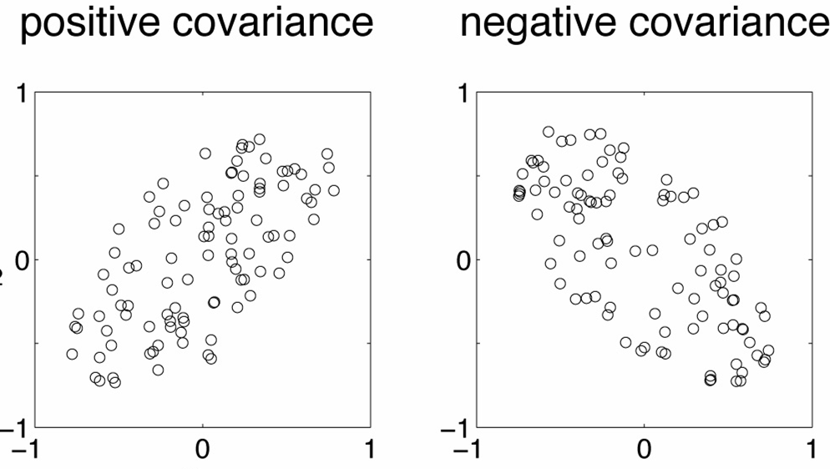
Covariance examples
Y
X

Slide 8
Covariance
Exact value is not as important as it’s sign.
A positive value of covariance indicates both
dimensions increase or decrease together e.g. as the
number of hours studied increases, the marks in that subject increase.
A negative value indicates while one increases the
other decreases, or vice-versa e.g. active social life at PSU vs performance in CS dept.
If covariance is zero: the two dimensions are independent of each other e.g. heights of students vs the marks obtained in a subject

Slide 9
Covariance
Why bother with calculating covariance when we could just plot the 2 values to see their relationship?
Covariance calculations are used to find relationships between dimensions in high dimensional data sets (usually greater than 3) where visualization is difficult.

Slide 10
PCA
principal components analysis (PCA) is a technique that can be used to simplify a dataset
It is a linear transformation that chooses a new coordinate system for the data set such that
greatest variance by any projection of the data set comes to lie on the first axis (then called the first principal component),
the second greatest variance on the second axis, and so on.
PCA can be used for reducing dimensionality by eliminating the later principal components.

Slide 11
PCA Toy Example
Consider the following 3D points
1
2
3
2
4
6
4
8
12
3
6
9
5
10
15
6
12
18
If each component is stored in a byte, we need 18 = 3 x 6 bytes

Slide 12
PCA Toy Example
Looking closer, we can see that all the points are related geometrically: they are all the same point, scaled by a factor:
1
2
3
1
2
3
2
4
6
1
2
3
4
8
12
1
2
3
= 1 *
= 2 *
= 4 *
3
6
9
1
2
3
5
10
15
1
2
3
6
12
18
1
2
3
= 3 *
= 5 *
= 6 *

Slide 13
PCA Toy Example
1
2
3
1
2
3
2
4
6
1
2
3
4
8
12
1
2
3
= 1 *
= 2 *
= 4 *
3
6
9
1
2
3
5
10
15
1
2
3
6
12
18
1
2
3
= 3 *
= 5 *
= 6 *
They can be stored using only 9 bytes (50% savings!): Store one point (3 bytes) + the multiplying constants (6 bytes)

Slide 14


Geometrical Interpretation:
View each point in 3D space.
p3
p2
p1
But in this example, all the points happen to belong to a line: a 1D subspace of the original 3D space.

Slide 15
Geometrical Interpretation:
Consider a new coordinate system where one of the axes is along the direction of the line:
p3
p2
p1
In this coordinate system, every point has only one non-zero coordinate: we only need to store the direction of the line (a 3 bytes image) and the non- zero coordinate for each of the points (6 bytes).

Slide 16
Principal Component Analysis (PCA)
Given a set of points, how do we know if they can be compressed like in the previous example?
The answer is to look into the correlation between the points
The tool for doing this is called PCA

Slide 17
PCA
By finding the eigenvalues and eigenvectors of the covariance matrix, we find that the eigenvectors with the largest eigenvalues correspond to the dimensions that have the strongest correlation in the dataset.
This is the principal component.
PCA is a useful statistical technique that has found application in:
fields such as face recognition and image compression
finding patterns in data of high dimension.

Slide 18
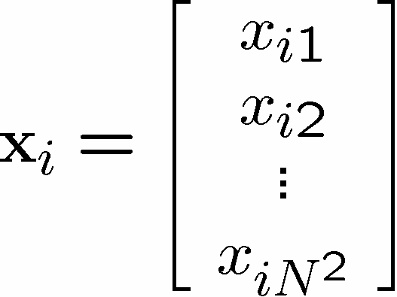
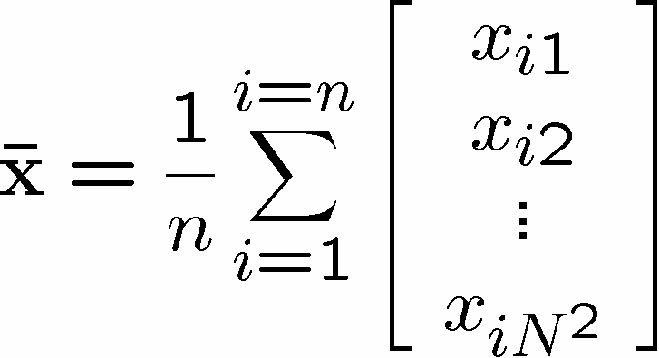
PCA Theorem
Let x₁ x₂ … x_{n} be a set of n N x 1 vectors and let x be their average:

Slide 19
PCA Theorem
Let X be the N x n matrix with columns x₁ - x, x₂ – x,… x_{n} –x :
Note: subtracting the mean is equivalent to translating the coordinate system to the location of the mean.

Slide 20
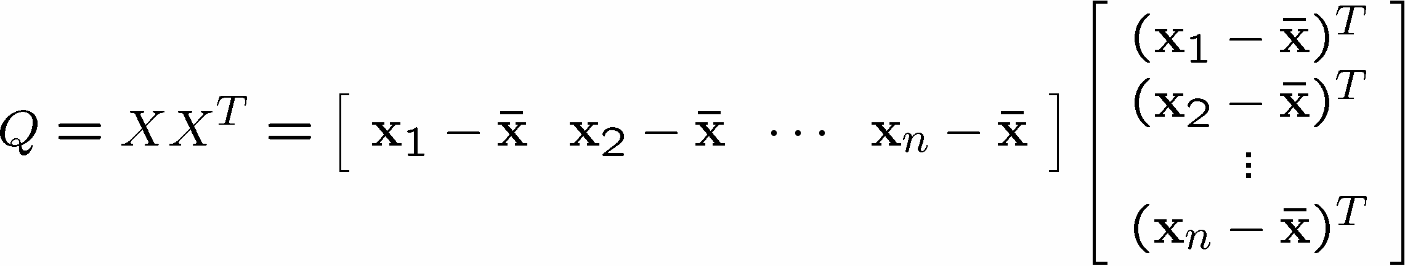
PCA Theorem
Let Q = X X^{T} be the N x N matrix:
Notes:
Q is square
Q is symmetric
Q is the covariance matrix [aka scatter matrix]
Q can be very large (in vision, N is often the number of pixels in an image!)

Slide 21
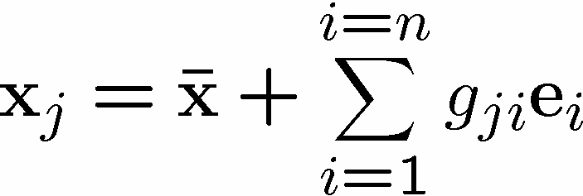

PCA Theorem
Theorem:
Each x_{j} can be written as:
where e_{i} are the n eigenvectors of Q with non-zero eigenvalues.
Notes:
The eigenvectors e₁ e₂ … e_{n} span an eigenspace
e₁ e₂ … e_{n} are N x 1 orthonormal vectors (directions in N-Dimensional space)
The scalars g_{ji} are the coordinates of x_{j} in the space.

Slide 22
Using PCA to Compress Data
Expressing x in terms of e₁ … e_{n} has not changed the size of the data
However, if the points are highly correlated many of the coordinates of x will be zero or closed to zero.
note: this means they lie in a lower-dimensional linear subspace

Slide 23


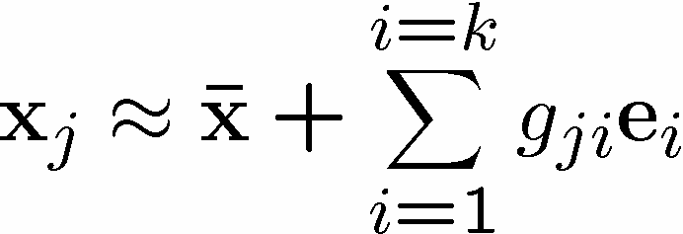
Using PCA to Compress Data
Sort the eigenvectors e_{i} according to their eigenvalue:
Assuming that
Then

Slide 24
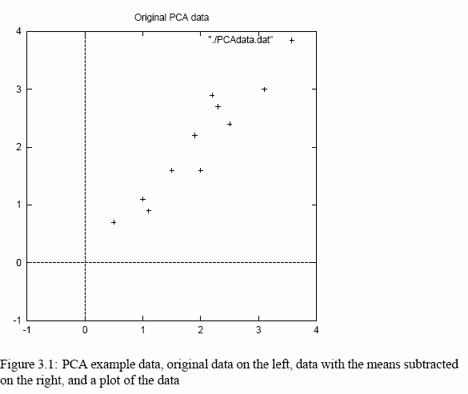
PCA Example –STEP 1
http://kybele.psych.cornell.edu/~edelman/Psych-465-Spring-2003/PCA-tutorial.pdf
DATA:
x
2.5 2.4
0.5 0.7
2.2 2.9
1.9 2.2
3.1 3.0
2.3 2.7
2 1.6
1 1.1
1.5 1.6
1.1 0.9
y
mean
this becomes the new origin of the data from now on

Slide 25
PCA Example –STEP 2
Calculate the covariance matrix
cov =
.616555556 .615444444
.615444444 .716555556
since the non-diagonal elements in this covariance matrix are positive, we should expect that both the x and y variable increase together.

Slide 26
PCA Example –STEP 3
Calculate the eigenvectors and eigenvalues of the covariance matrix
eigenvalues = .0490833989
1.28402771
eigenvectors = -.735178656 -.677873399
.677873399 -735178656

Slide 27
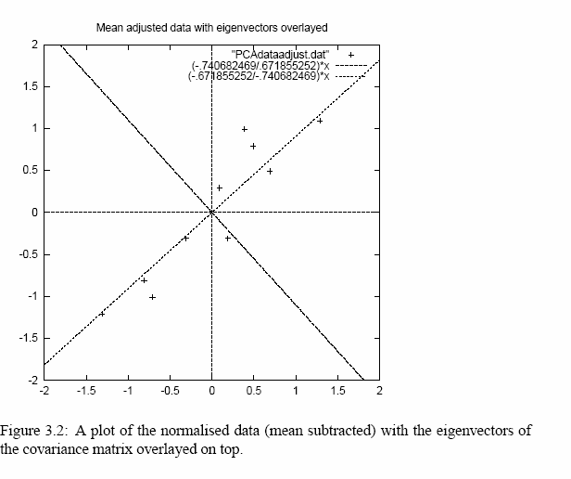
PCA Example –STEP 3
•eigenvectors are plotted as diagonal dotted lines on the plot.
•Note they are perpendicular to each other.
•Note one of the eigenvectors goes through the middle of the points, like drawing a line of best fit.
•The second eigenvector gives us the other, less
important, pattern in the data, that all the points follow the main line, but are off to the side of the main line by some amount.

Slide 28
PCA Example –STEP 4
Feature Vector
FeatureVector = (eig₁ eig₂ eig₃ … eig_{n})
We can either form a feature vector with both of the eigenvectors:
-.677873399 -.735178656
-.735178656 .677873399
or, we can choose to leave out the smaller, less significant component and only have a single column:
- .677873399
- .735178656

Slide 29
PCA Example –STEP 5
Deriving new data coordinates
FinalData = RowFeatureVector x RowZeroMeanData
RowFeatureVector is the matrix with the eigenvectors in the columns transposed so that the eigenvectors are now in the rows, with the most significant eigenvector at the top
RowZeroMeanData is the mean-adjusted data transposed, ie. the data items are in each column, with each row holding a separate dimension.
Note: his is essential Rotating the coordinate axes so higher-variance axes come first.

Slide 30
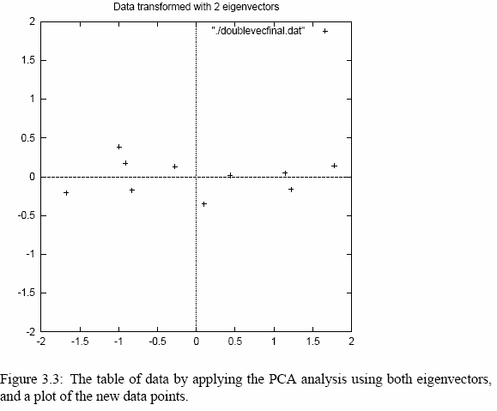
PCA Example –STEP 5

Slide 31
PCA Example : Approximation
If we reduced the dimensionality, obviously, when reconstructing the data we would lose those dimensions we chose to discard. In our example let us assume that we considered only the x dimension…

Slide 32
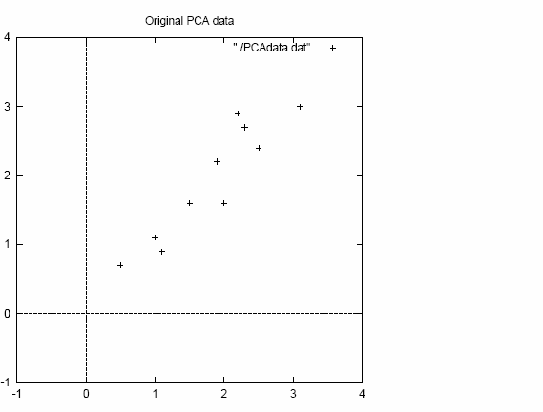
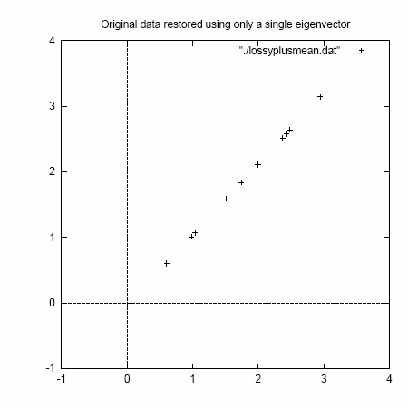
PCA Example : Final Approximation
2D point cloud
Approximation using one eigenvector basis

Slide 33
Another way of thinking about Principal component
direction of maximum variance in the input space
happens to be same as the principal eigenvector of the covariance matrix

Slide 34
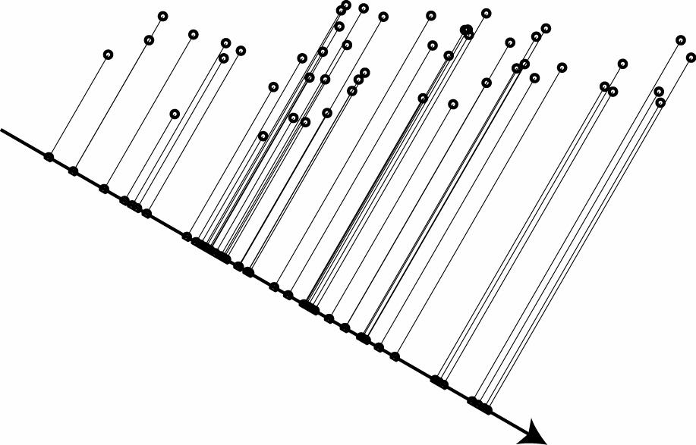
One-dimensional projection
find projection that maximizes variance

Slide 35
Covariance to variance
From the covariance, the variance of any projection can be calculated.
Let w be a unit vector
(w^{T} x)²
w^{T} x ² = w^{T} Cw
⁼ ∑^{w}i^{C}ij ^{w}j ij

Slide 36
Maximizing variance
Principal eigenvector of C
– the one with the largest eigenvalue.
w* = argmax w^{T} Cw
w: w =1
λ (C) = max w^{T} Cw
max
w: w =1
= w^{*T} Cw*

Slide 37
Implementing PCA
Need to find “first” k eigenvectors of Q:
Q is N x N (Again, N could be the number of pixels in an image. For a 256 x 256 image, N = 65536 !!)
Don’t want to explicitly compute Q!!!!

Slide 38

Singular Value Decomposition (SVD)
Any m x n matrix X can be written as the product of 3 matrices:
Where:
U is m x m and its columns are orthonormal vectors
V is n x n and its columns are orthonormal vectors
D is m x n diagonal and its diagonal elements are called the singular values of X, and are such that:
σ₁ ¸ σ₂ ¸ … σ_{n} ¸ 0

Slide 39
SVD Properties
The columns of U are the eigenvectors of XX^{T}
The columns of V are the eigenvectors of X^{T}X
The squares of the diagonal elements of D are the eigenvalues of XX^{T} and X^{T}X

